Slide 1

Stacks & Queues
CISC 610
Data Structures
Brian Grey

Slide 2
What are we doing today?
What is an abstract data type?
Stack
Behavior and interface
Example implementation
Queues
Behavior and interface
Example implementation

Slide 3
Abstract Data Types
What is abstraction? (Again?)
Using only the essential elements to describe a system and leaving the more complex aspects to a lower level system
This is the opposite of a concrete data structure
(A low-level data structure that is literally implemented as a well-defined solution to a problem)
Definitionally, abstract data types (ADTs) define:
The interface of the data structure
Data stored within the data structure
Error conditions associate with any operations

Slide 4
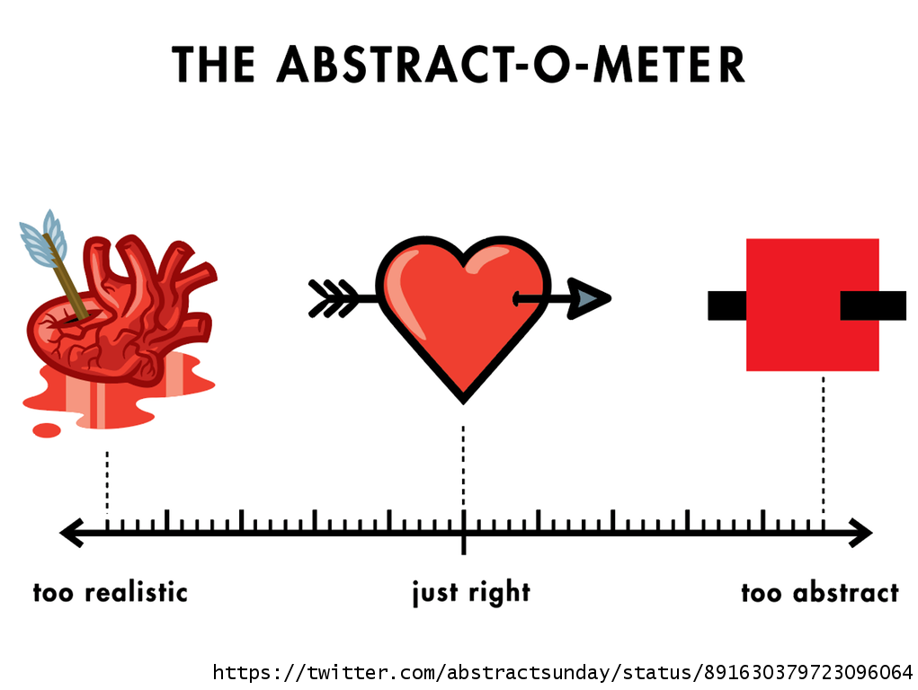
Abstract Data Types
What is abstraction? (Again?)
Using only the essential elements to describe a system and leaving the more complex aspects to a lower level system
The trick is being able to determine what are essential elements and what aspects can be handed off to another system
Too abstract means that you will likely miss key functionality
Too detailed means that you are likely doing unnecessary work

Slide 5
Abstract Data Types
What does this mean on a practical level?
ADTs explicitly defines interface and behavior
ADTs are implemented on top of another data structure
May be implemented with concrete data structure
For example, as we will discuss, stacks and queues can be implemented with an array or a linked list backing it
May be implemented on top of another ADT
Stacks and queues may be implemented with a dynamic array which is an ADT on implemented with a static array

Slide 6
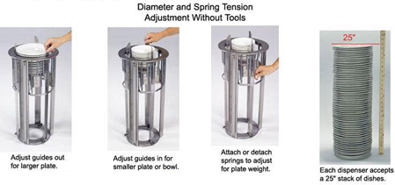

Stacks
Anyone know what this is?

Slide 7
Stacks
This spring-loaded plate stacker is the inspiration for the name of a stack
Stacks are last-in, first-out (LIFO) abstract data structures that can store objects of an arbitrary type
All access to the content of the stack is done from the same end
You can NEVER see inside of the stack
One of the oldest ADTs and is implemented at a low level for computer languages and operating systems
Proposed by Alan Turing in 1946
Has been used in computer architecture since the mid-1950’s

Slide 8
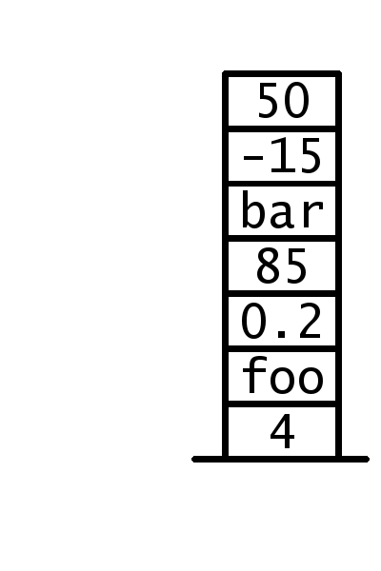
Stack Terminology
The terminology surrounding a stack has not changed since it was first implemented
This means that if you spoke to a computer scientist from 1960, you could discuss stacks using some standard terminology
Because stacks are named for the “plate stacker” analogy, they take a vertical orientation
The first/oldest element in a stack is said to be “on the bottom of the stack”

Slide 9
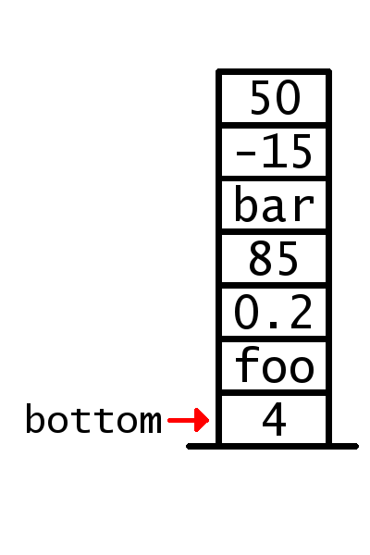
Stack Terminology
The terminology surrounding a stack has not changed since it was first implemented
This means that if you spoke to a computer scientist from 1960, you could discuss stacks using some standard terminology
Because stacks are named for the “plate stacker” analogy, they take a vertical orientation
The first/oldest element in a stack is said to be “on the bottom of the stack”
The most recently added element is “on top”

Slide 10
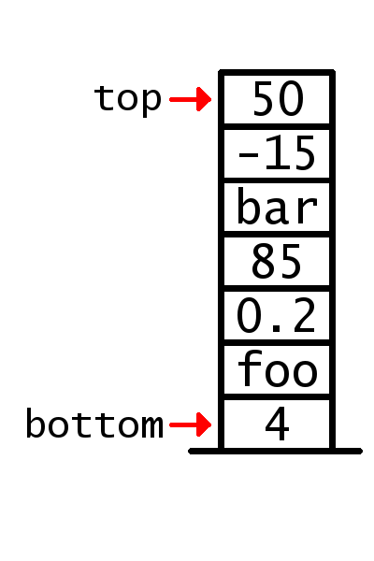
Stack Terminology
The terminology surrounding a stack has not changed since it was first implemented
This means that if you spoke to a computer scientist from 1960, you could discuss stacks using some standard terminology
Because stacks are named for the “plate stacker” analogy, they take a vertical orientation
The first/oldest element in a stack is said to be “on the bottom of the stack”
The most recently added element is “on top”
FIRST AND LAST HAS NO MEANING WITH STACKS

Slide 11
Stack Interface
Similarly, the interface is largely unchanged
Primary methods of a stack:
S.push(object): puts a new object on top of the stack
S.pop(): attempts to take an object off the top of the stack
Additional methods common to stacks:
S.peek() or S.top(): attempts to access the object on the top of the stack without removing it from the stack
len(S): returns the number of elements in the stack
S.is_empty(): returns true if there are no elements in the stack
Errors occur if the stack is empty and pop, peek, or top is called

Slide 12
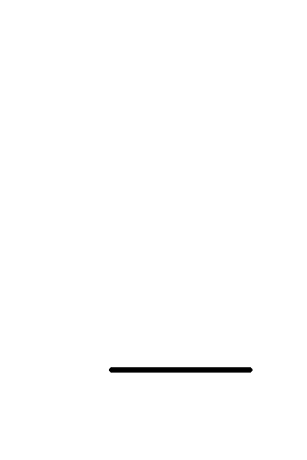
Stack example
Let’s examine the contents of a stack during the following:
s = Stack() s.push(1) s.push(2) print( len(s) ) s.push(3) print( s.pop() ) print( s.pop() ) print( s.top() ) print( s.is_empty() ) print( s.pop() ) print( s.is_empty() ) print( s.top() ) s.push(4)

Slide 13
Stack Implementations
As a stack is an ADT, we need a data type as a backing data structure to store our data
Three options:
Linked List
Array
Dynamic Array

Slide 14

Stack Implementation #1: Linked List
Stacks only add and remove from one end
If we are implementing using a linked list, what is the operation that we want to avoid using?
Access of an arbitrary element is $O\left(n\right)$
Getting to an element not near the front of the list is slow
What operations/list states do we want to take advantage of?
Adding to and removing from a linked list is FAST
Accessing the head node is FAST

Slide 15

Stack Implementation #1: Linked List
What does this mean for our design?
Therefore, the top of the stack should be the head node
Pushing onto a stack = adding in front of the current head node
Popping off of the stack = removing the current head node and returning the element inside
Peeking at the top of the stack = accessing the element at the current head node
Under this design, all operations of the stack are $O\left(1\right)$!
But linked lists do eat up more memory than arrays…

Slide 16

Stack Implementation #2: Array
Stacks only add and remove from one end
If we are implementing using an array, what is the operation that we want to avoid using?
Adding an element at an arbitrary index is $O\left(n\right)$
Because all elements after the index must be copied down
What operations/list states do we want to take advantage of?
Accessing an arbitrary index is FAST
Overwriting data at an arbitrary index is FAST
So, if the slot is unused, then we can get to and overwrite it quickly

Slide 17
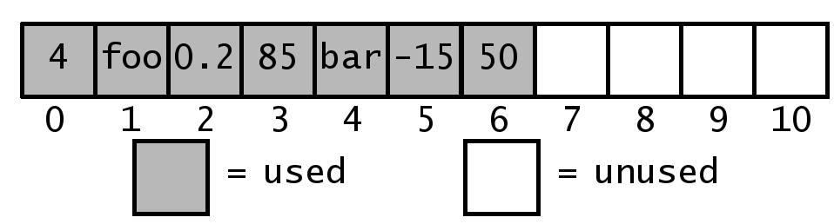

Stack Implementation #2: Array
What does this mean for our design?
First, we must create an array that is larger than we need
If we “left justify” the data, we know where the bottom is
We can then write to any unused slot in the array in $O\left(1\right)$

Slide 18
Stack Implementation #2: Array
What does this mean for our design?
Therefore, the top of the stack should be the end of the currently used portion of our array
Pushing onto a stack = writing to the first slot past the used portion of the array (at an index of len(S) )
Popping off of the stack = saving the element at len(S)-1, overwriting that slot, decrementing your length variable, and returning the saved element
Peeking at the top of the stack = accessing the element at len(S)-1

Slide 19

Stack Implementation #2: Array
What does this mean for our design?
Therefore, the top of the stack should be the end of the currently used portion of our array
Under this design, all operations of the stack are $O\left(1\right)$!
Just like the linked list implementation!
However, the memory representation is more tightly aligned and uses less memory
Of course, there is a risk that you didn’t make the array big enough in the beginning
I hate having to resize my arrays…

Slide 20

Stack Implementation #3: Dynamic Array
The same as an array, only we don’t have to resize
All implementation details are identical
But we do not have to resize our array when we run out of space
Python uses a geometric resizing approach, meaning that resizes are done as a proportion of the current size
Resize operations become less common as the array grows
Under this paradigm, adding to a dynamic array is amortized to $O\left(1\right)$
Under this design, all operations of the stack are $O\left(1\right)$!
Seems like the optimal solution. Let’s code it!

Slide 21
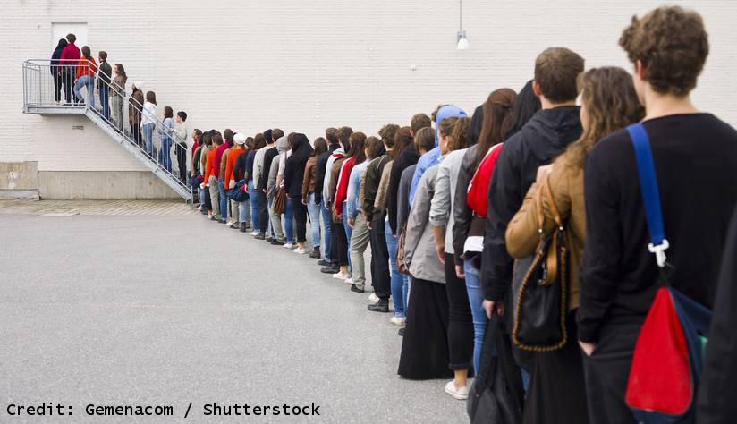
Queues
What does the word “queue” conjure images of?

Slide 22
Queues
This bureaucratic nightmare is the inspiration for the name of a queue
Queues are first-in, first-out (FIFO) abstract data structures that can store objects of an arbitrary type
Access to the content of the queue is done on the opposite end of where the data is entered
You can NEVER see inside of the queue
Very common data structure for ordering and prioritizing data

Slide 23
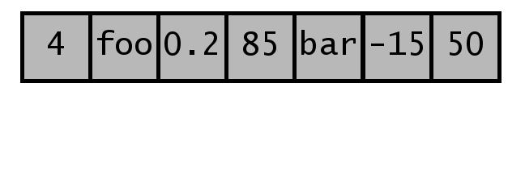
Queue Terminology
While not as old as stacks, the terminology surrounding queues has long been standardized
Like most linear data structures, they take a horizontal orientation
The first/oldest element in a queue is said to be “at the front of the queue”

Slide 24
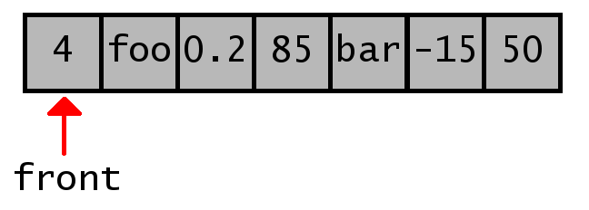
Queue Terminology
While not as old as stacks, the terminology surrounding queues has long been standardized
Like most linear data structures, they take a horizontal orientation
The first/oldest element in a queue is said to be “at the front of the queue”
The most recently added element is “at the back”

Slide 25
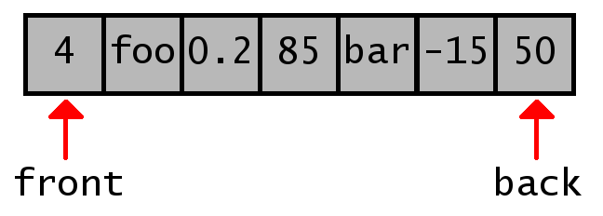
Queue Terminology
While not as old as stacks, the terminology surrounding queues has long been standardized
Like most linear data structures, they take a horizontal orientation
The first/oldest element in a queue is said to be “at the front of the queue”
The most recently added element is “at the back”

Slide 26
Queue Interface
Like its terminology, the queue’s interface is standardized
Primary methods of a queue:
Q.enqueue(object): puts a new object at the back of the queue
Q.dequeue(): attempts to take an object off the front of the queue
Additional methods common to queues:
Q.front() or Q.first(): attempts to access the object on the front of the queue without removing it from the queue
len(Q): returns the number of elements in the queue
Q.is_empty(): returns true if there are no elements in the queue
Errors occur if the queue is empty and dequeue, front, or first is called

Slide 27
Queue example
Let’s examine the contents of a queue during the following:
q = Queue() q.enqueue(1) q.enqueue(2) print( len(q) ) q.enqueue(3) print( q.dequeue() ) print( q.dequeue() ) print( q.front() ) print( q.is_empty() ) print( q.dequeue() ) print( q.is_empty() ) print( q.front() ) q.enqueue(4)

Slide 28
Queue Implementations
As a queue is an ADT, we need a data type as a backing data structure to store our data
Three options:
Linked List
Array
Dynamic Array

Slide 29

Queue Implementation #1: Linked List
Queues require only add on one end and removing from the other
If we are implementing using a linked list, what is the operation that we want to avoid using?
Access of an arbitrary element is $O\left(n\right)$
Getting to an element not near the front of the list is slow
Uh oh…how do we get around this?
If we implement a tail link, we can remember where the last element of our linked list is as well
This eliminates the need to iteratively find the last node

Slide 30

Queue Implementation #1: Linked List
What does this mean for our design?
With this, the front of the list should be the head
Enqueuing into the queue = adding behind the tail node then updating the tail node
Dequeuing from the queue = removing the current head node and returning the element inside
Looking at the front of the queue = accessing the element at the current head node
Under this design, all operations of the stack are $O\left(1\right)$!
But linked lists do eat up more memory than arrays…

Slide 31

Queue Implementation #2: Array
Queues add on one end and remove from the other
If we are implementing using an array, what is the operation that we want to avoid using?
Adding an element at an arbitrary index is $O\left(n\right)$
Because all elements after the index must be copied down
What operations/list states do we want to take advantage of?
Accessing an arbitrary index is FAST
Overwriting data at an arbitrary index is FAST
So, if the slot is unused, then we can get to and overwrite it quickly

Slide 32

Queue Implementation #2: Array
What does this mean for our design?
First, we must create an array that is larger than we need
We can also “left justify” the data, just like we did with a stack
But then every time we dequeue, everything has to be shifted
This action is $O\left(n\right)$

Slide 33
Queue Implementation #2: Array
What does this mean for our design?
If we don’t “left justify” the data, now need to track the front

Slide 34
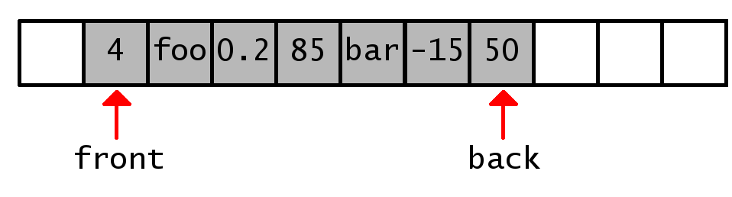

Queue Implementation #2: Array
What does this mean for our design?
If we don’t “left justify” the data, now need to track the front
Also need know where the back is (front + queue length – 1)
All actions are writing to empty slots or incrementing indicies
These actions are $O\left(1\right)$

Slide 35
Queue Implementation #2: Array
What’s the potential problem?
Let’s walk through some actions:

Slide 36
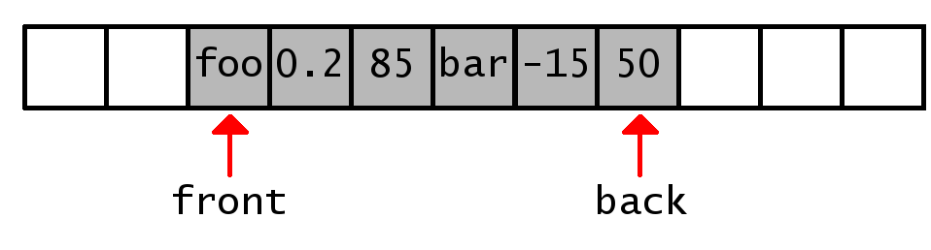
Queue Implementation #2: Array
What’s the potential problem?
Let’s walk through some actions:

Slide 37
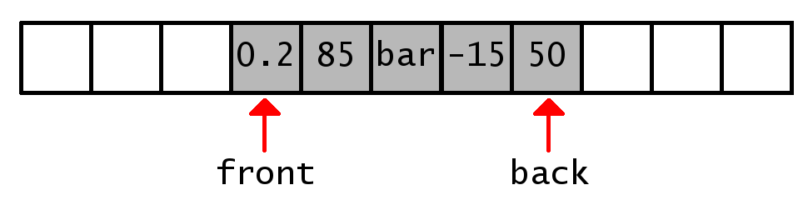
Queue Implementation #2: Array
What’s the potential problem?
Let’s walk through some actions:

Slide 38
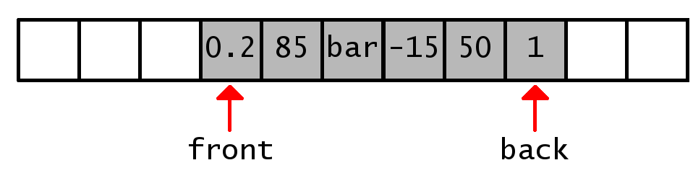
Queue Implementation #2: Array
What’s the potential problem?
Let’s walk through some actions:

Slide 39
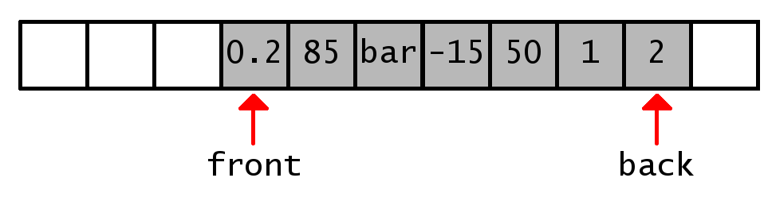
Queue Implementation #2: Array
What’s the potential problem?
Let’s walk through some actions:

Slide 40
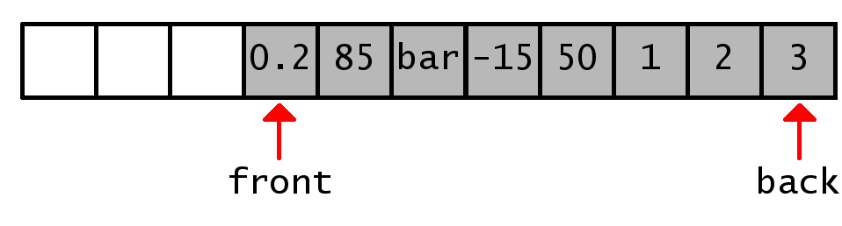

Queue Implementation #2: Array
What’s the potential problem?
Let’s walk through some actions:
Uh………now what?
We could shift everything down but then we’re back where we started with actions running at $O\left(n\right)$ OR…

Slide 41
Queue Implementation #2: Array
We can treat our static array like a circular array
Once we move past the end of the array, we start adding to the empty slots at the beginning of the array
How do we know if we’re in a “standard” or circular configuration?
Our “back index” calculation is (front + queue length – 1)
If that’s greater than (array size – 1), then we’re circular
Otherwise, we’re in a standard configuration

Slide 42
Queue Implementation #2: Array
We can treat our static array like a circular array
Because of this, the actual equation for the index of the element at the back of the queue in a circular array is:
(front + queue length – 1) % (array size)
The index for the next empty slot for the queue to enqueue into in a circular array is:
(front + queue length) % (array size)

Slide 43
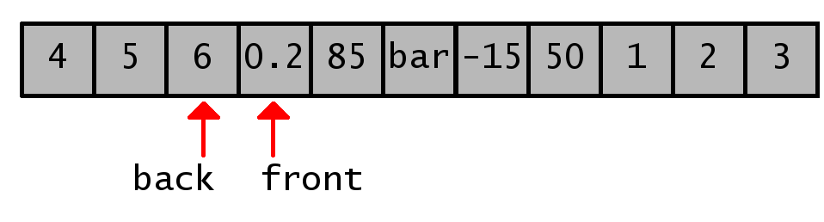
Queue Implementation #2: Array
What does this mean for our design?
Resizing becomes a challenge
What happens when we expand this array?

Slide 44
Queue Implementation #2: Array
What does this mean for our design?
Resizing becomes a challenge
Doing a strict expansion would introduce gaps in the data
BAD!
Best practice is to reset the front of queue to be at the beginning of the array during the copy portion of the array expansion process

Slide 45
Queue Implementation #3: Dynamic Array
Don’t
As we just saw, it helps to have control over the resize process for resetting the front of the queue to the beginning of the array
What will happen if you use maintain a “circular” paradigm and don’t control when and how the resize process happens?
Will the array ever be circular?
What will the dynamic array look like after 1 million elements have be enqueued and 999,999 elements have been dequeued?
One lonely element with 999,999 empty slots preceding it

Slide 46
Questions?

